Slide 1
DIFF Leadership Masterclass
Neurodiversity
16th June 2022

Slide 2
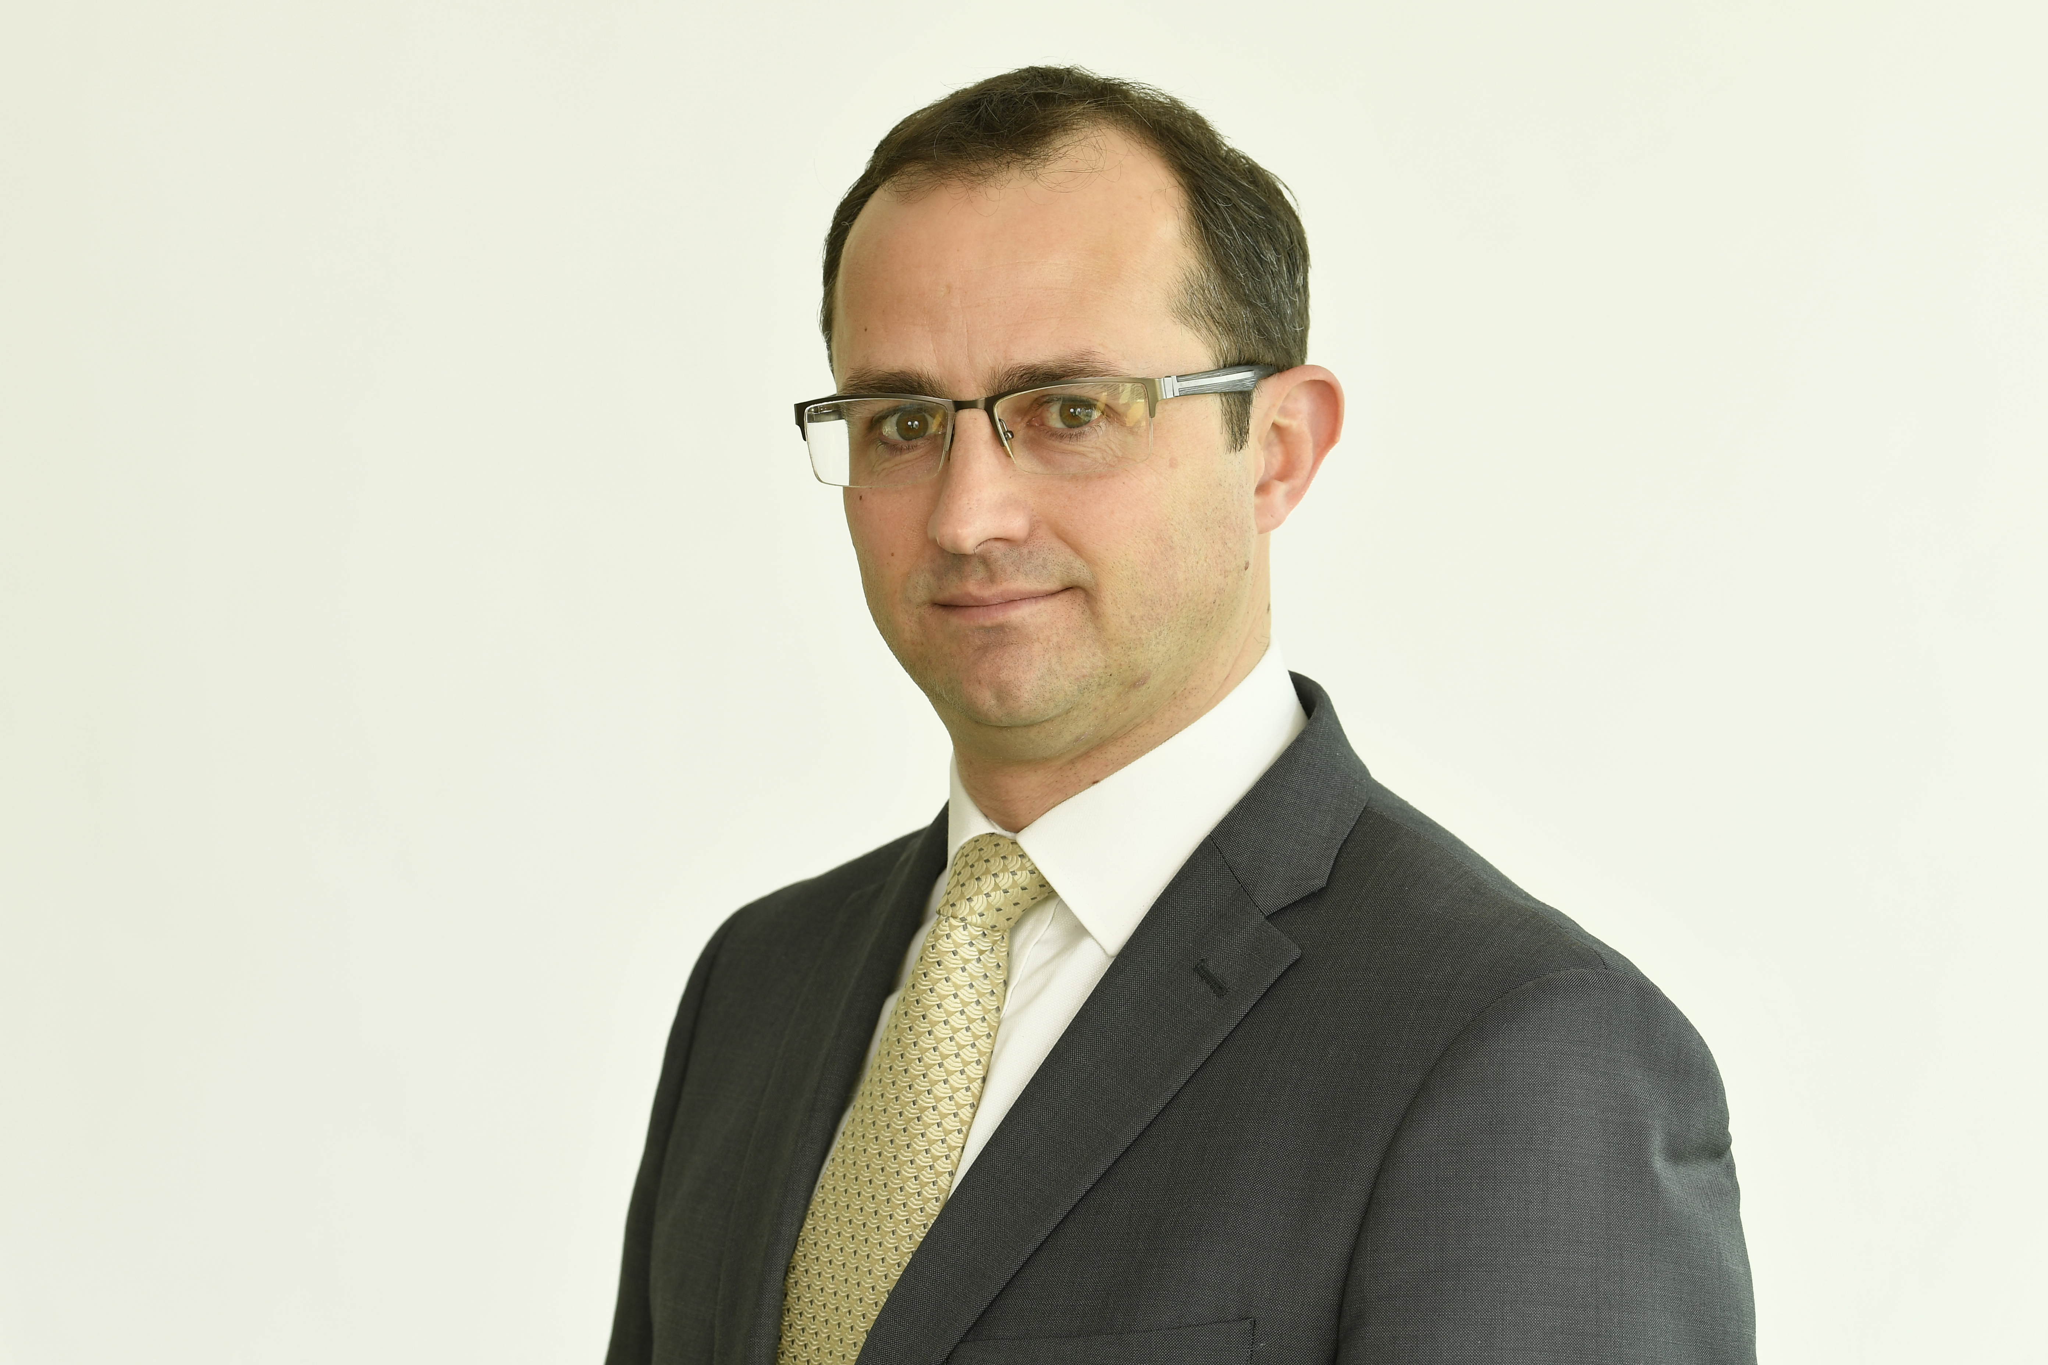
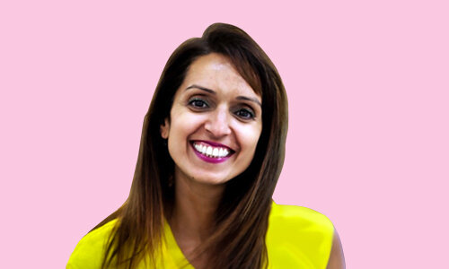
Your Hosts Today….
Kieron O’Reilly
D&I Consultant
Kieron.o’reilly@brookgraham.com
M: 07887 994 918
Punum Telford
D&I Consultant
punum.Telford@brookgraham.com
M: 07862 325 6773

Slide 3
Masterclass Aims
A short taster session to:
  Equip leaders with language to engage with neurodiversity
  Understand models of approach to neurodiversity
  Leave with a questioning mindset
  Share best practice - how other industries approach neurodiversity
  Takeaway tips

Slide 4


Today’s Agenda
What is Neurodiversity?
Reframe Neurodiversity
Best Practices
Wrap Up
Neuro-proficiency as Employers
Approach to Neurodiversity
Misconceptions & Biases
Experiencing Neurodivergence

Slide 5
Quick question
How comfortable are you using the language & terminology that is used around neurodiversity on a day to day basis?
Go to
www.ment.com and use the code 2725 6307

Slide 6

Your Approach to Neurodiversity
Mindset to approaching Neurodiversity
Not trying to fix a healthcare condition
Accessibility to employment
Widening pool of diverse skills
Support model of managing people
This Photo by Unknown Author is licensed under CC BY-SA-NC

Slide 7
What is Neurodiversity?
Neurodiversity = different ways the brain can work and interpret information
People naturally think about things differently
Everyone is differently able as we are all born different and raised differently
Neurotypical = brain functions and processes information in the way society expects
1 in 7 people (more than 15% of people in the UK) are neurodivergent
Brain functions, learns and processes information differently
Includes Attention Deficit Disorders, Autism, Dyslexia and Dyspraxia

Slide 8
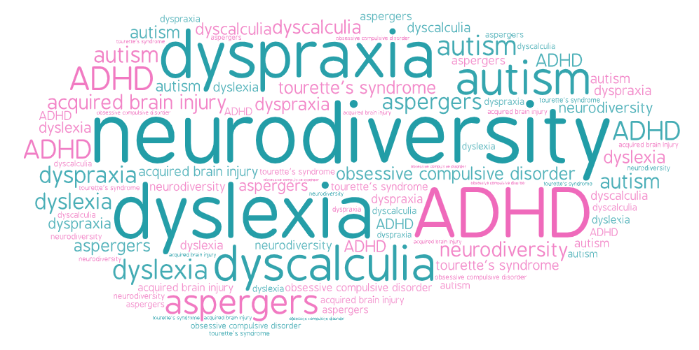

Slide 9
Medical v Social Models
Medical Model | Social Model
Disorders | Skills
What’s wrong | What’s needed
Deficit based | Strengths based
Low expectations | Tap into potential
Loss of choice, control & independence | Enable self-empowerment
The person is the problem | Barriers are created by society
Cure | Support & Resources
Fixed Mindset | Growth Mindset

Slide 10
Misconceptions & Biases
Need to be molly coddled
Lazy
Applies to males
Low IQ
Something you grow out of
Females can’t have it

Slide 11
Reframe Neurodiversity
Reframe your approach as enabling a diverse culture & accessing a highly valuable set of skills
Specialised
Pattern Recognition
Mathematics
Solutions
Highly focused
Differing insights & perspectives
Avoid group think
Memory
Problem solvers
Don’t tolerate the status quo, disorder or things not working
Perspective
Innovative
See things differently
Conceive new ways of doing things
Notes:
Neurodivergent individuals are highly skilled especially in pattern recognition, memory, or mathematics
They are wired differently to neurotypical people. Which means they may bring different insights, perspectives and solutions
Consider including people from the ‘edges’
They see things differently and don’t fit in seamlessly. This prevents group think and limitations to the same approaches and solutions

Slide 12
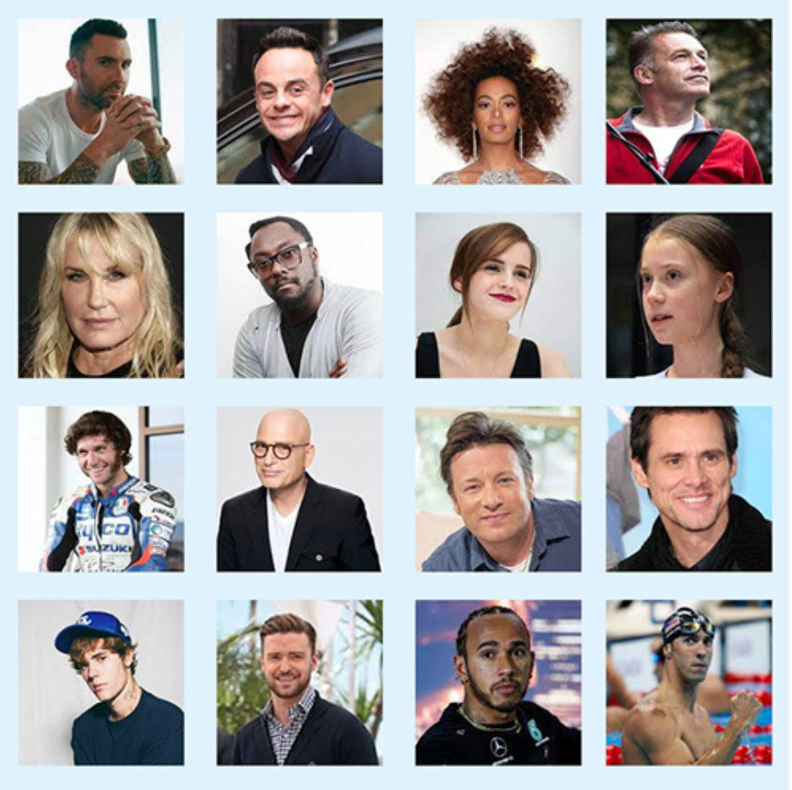

Ability or Disability?

Slide 13
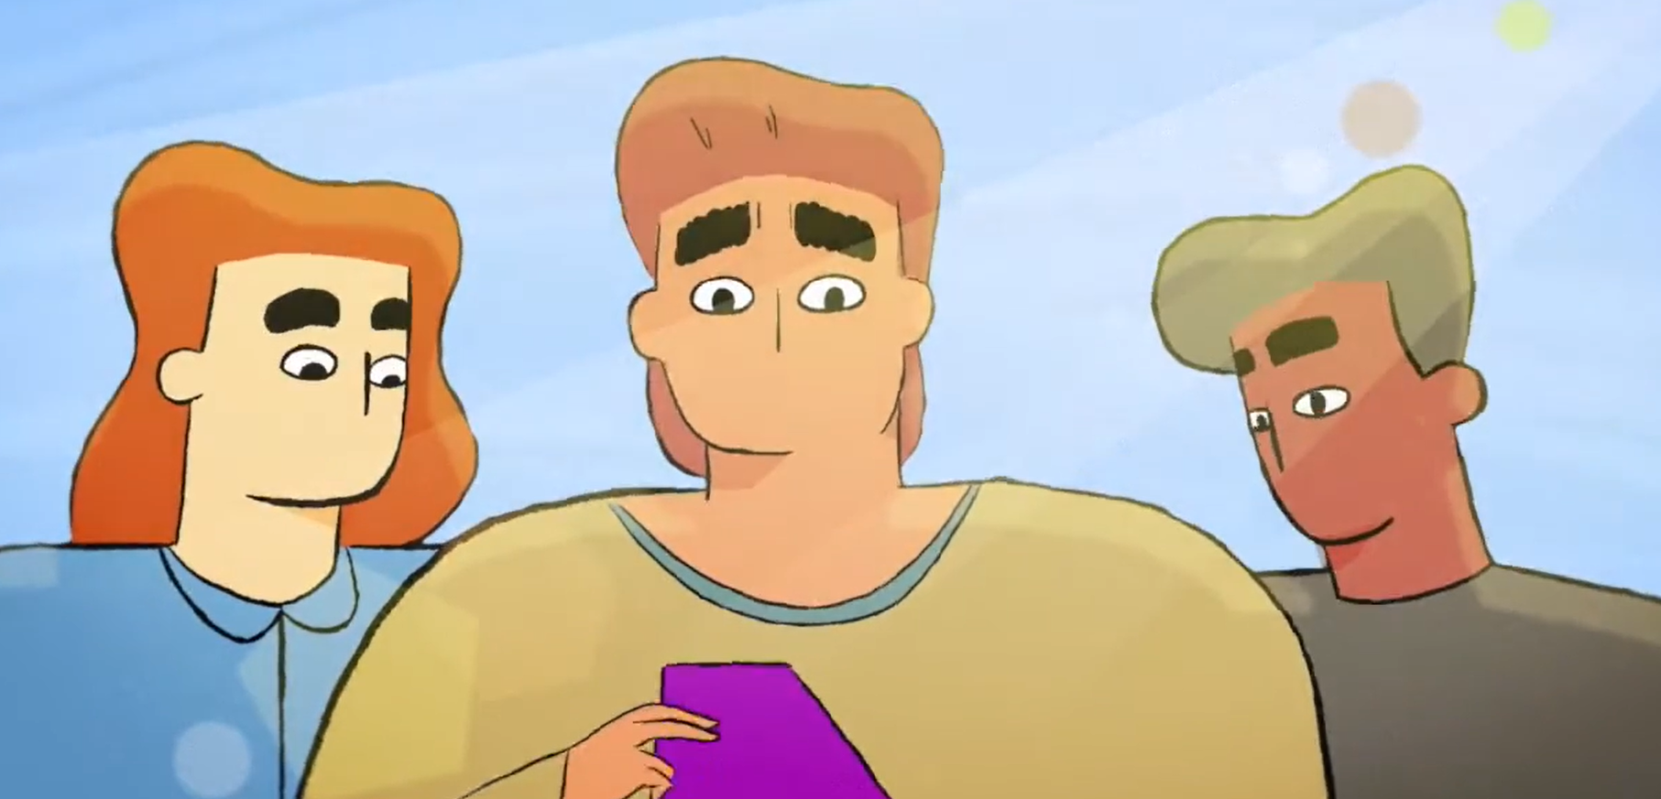
Experience exercise
Sensory Exercise - *Note we recommend you don’t do this exercise if you have sensitivity to sensory stimuli
Huddle together as close as possible with chairs crowded next to each other
Play music or any talking sounds on your phone
Turn on your phone light and direct it towards yourself
When we say start, everyone speaks at the same time to explain why you’re here today
Reflect –
What did you notice?
Where did you sense it in your physiology?
How was your focus?
How did you feel?
Notes:
https://www.youtube.com/watch?v=9WXJgL0glNU

Slide 14
Best Practices in the Workplace
NASA – Proactive selection of Neurodivergent skills
JP Morgan - Recruitment experience
Named as ‘Outstanding Employer’ by National Autistic Society for Autism Professionals Awards
SAP – Innovation by Neurodiverse Teams
Notes:
Nasa:
Over 50% of NASA employees are dyslexic
Deliberately recruited for superb problem-solving skills, excellent 3D and spatial awareness
JP Morgan:
Google maps & virtual tour of building prior to interview
photo of person you’ll be meeting
may bring a support person
Walk them through the environment and modify it (lighting, headphones, etc.)
Autism at Work program is in 9 countries
SAP:
One employee generated significant innovations
Helping to develop a technical fix worth an estimated $40 million in savings

Slide 15
Developing Neuro-proficiency as Employers
Partner with not for profits experienced in working with people with neurodivergence
Find out if there are any specific needs ahead of interview / assessment / induction processes
Use non-standard interview / assessment practices
Coach other workers and managers in what to expect
Set up a support system
Tailor career management practices and criteria
Carry out regular wellbeing check ins for all staff
Develop greater sensitivity to differences and preferences across all employees
Scale the program to increase neurodiversity in the workforce
Mainstream the program to make all processes neurodiversity friendly
Notes:
Reframe neurodiversity
How organisations can enable these skills
pattern recognition, memory, or mathematics
wired differently to neurotypical people. May bring different insights, perspectives and solutions
include people from the ‘edges’
see things differently and don’t in seamlessly – prevents group think
Recruitment and career progression is designed for neurotypical individuals –
solid communication skills,
team player
emotional intelligence
persuasiveness
salesperson-type personalities
ability to network
ability to conform to standard practices without special accommodations, and so on.
These criteria systematically screen out neurodiverse people who:
often don’t make good eye contact
prone to conversational tangents
can be overly honest about their weaknesses
confidence problems arising from difficulties they experienced in previously in interview processes
more unlikely to earn higher scores in interviews than less-talented neurotypical candidates
Shift from standard processes to tailoring individual work practices and settings

Slide 16
Your Commitment
Who is the one person you could speak to in your organisation about Neurodiversity to create impact?
Notes:
What do want to achieve?
What is it that we could do better?
What are the experiences of colleagues who are neurodivergent?

Slide 17
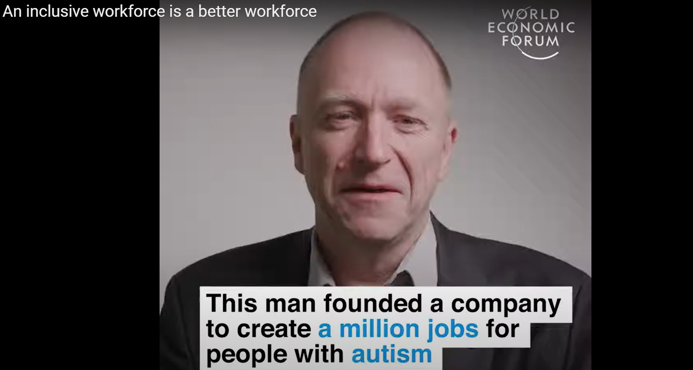
Wrap up:
Neurominority – An Inclusive workforce is a better workforce
Notes:
(4) An inclusive workforce is a better workforce - YouTube

Slide 18
Questions
Notes:
Timing: 10 minutes (16:45 – 16:55)

Slide 19
Resources and Further Reading
Neurodivercity Org Medical Model v Social Model
The Social Model of Disability_NDACA
Austistica - Understand More About Autism_Sensory Overload
HBR Org Neurodiversity as a Competitive Advantage
An Inclusive Workforce is a Better Workforce

Slide 20
Thank you!
Notes:
Session: Questions, Next Steps & Close (20 mins in total)
Facilitation notes: xxx
Delivery style: Facilitator-led presentation with group discussion
Prep required: xxx

